Slide 2
Benefits of Educational Travel

Slide 3
Benefits of Educational Travel
Expanded worldview
  Understanding and appreciation of different cultures
Personal growth
  Increased confidence and competence
  Language and cultural immersion
Life skills
  Demonstrates maturity and worldliness
  Enhances college and job applications

Slide 4
Why Explorica?
Proven experience
  50 years in student travel
  More than 1 million travelers
  Tours to 75 countries on all 7 continents
Incredible Tour Directors
  Professionally trained
  Specialized in student travel
  Local experts bring the destination to life
  With group 24/7
Excellent value
  Fully inclusive
  Quality hotels, meals & activities
  Guaranteed best prices
Exceptional safety record
  Proven systems in place at all levels of operations
  Worldwide network of support
  Unmatched in industry

Slide 5
By your side, always
Proactive risk management
Expertly trained, multilingual Tour Directors
24/7 On-Call Support Team
50+ years of safe travel experiences
Worldwide support network
Local staff and partnerships
Comprehensive liability coverage
Trusted travel protection plans
Upgraded Cancel for Any Reason policy

Slide 6
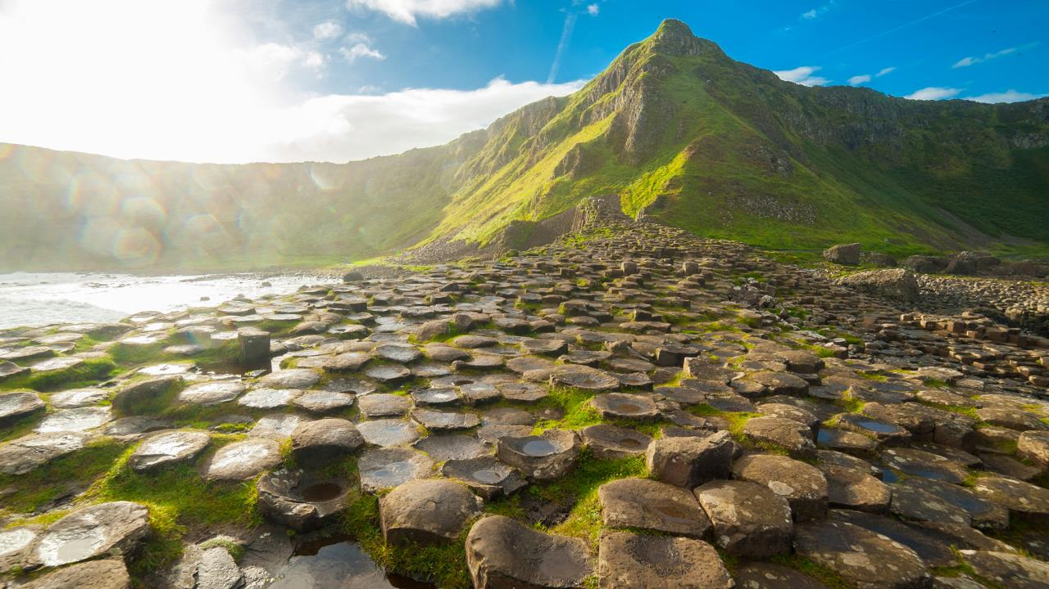
Dublin & the United Kingdom – Trip Cost: $4,156
September 21 - October 2, 2023

Slide 7
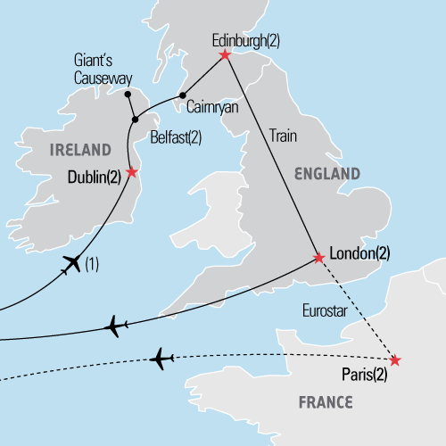
Where we’re going
Dublin & the United Kingdom
September 21 - October 2, 2023
12 days
Join this whirlwind tour of Dublin and the United Kingdom and discover the most popular sights of the British Isles with visits to Ireland, Northern Ireland, Scotland and England. See the Book of Kells in Dublin. Travel down Shankill Road in Belfast. Visit the Giant’s Causeway in County Antrim. Witness Edinburgh Castle up close. Then travel to London and experience some of the most famous landmarks of the English-speaking world.

Slide 8
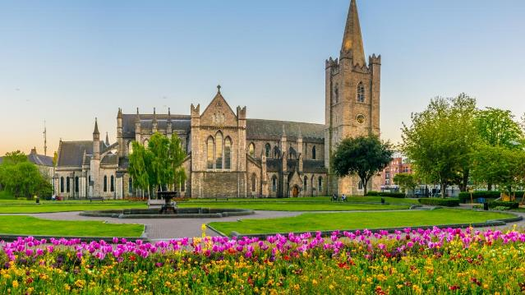
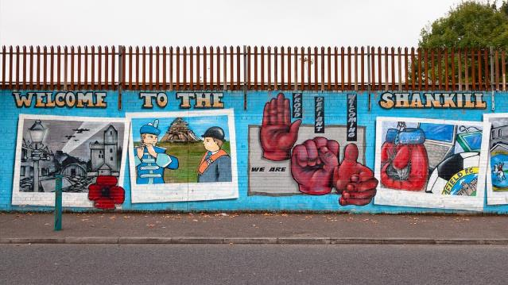
Tour Itinerary
DAY 1 | Start tour
DAY 2 | Hello Dublin
  Meet your tour director and check into hotel
  Dublin city walk: O’Connell Street, Parnell Square, Henry Street
DAY 3 | Dublin landmarks
  Dublin guided sightseeing tour: Phoenix Park, St. Patrick’s Cathedral, Trinity College Book of Kells visit
  Optional Powerscourt Gardens excursion - $60
  Traditional public house dinner
DAY 4 | Dublin--Belfast
  Travel to Belfast
  Belfast guided sightseeing tour: Lower Falls, Shankill Road, Belfast murals
ST. PATRICK’S CATHEDRAL
SHANKILL ROAD

Slide 9
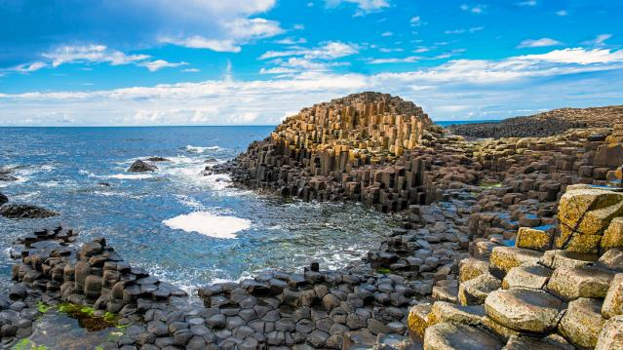
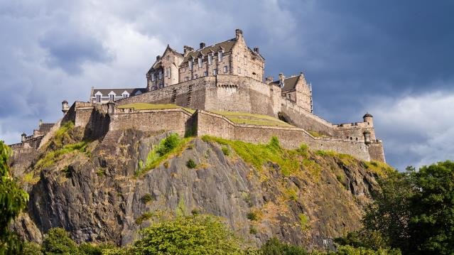
Tour Itinerary
DAY 5 | Giant's Causeway & Derry
  Giant's Causeway excursion
  Derry guided sightseeing tour
DAY 6 | Belfast--Edinburgh
  Ferry to Cairnryan
  Travel to Edinburgh
  Edinburgh city walk: Charlotte Square, Alexander Graham Bell’s home, Robert Louis Stevenson’s home, Robert Burns Monument
DAY 7 | Edinburgh landmarks
  Edinburgh guided sightseeing tour: Royal Mile, Old Town, Sir Walter Scott Monument
  Edinburgh Castle visit
GIANT’S CAUSEWAY
EDINBURGH CASTLE

Slide 10
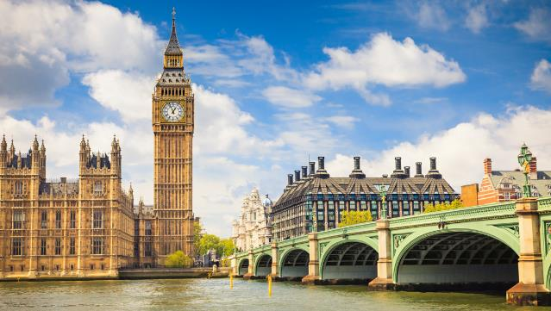

Tour Itinerary
End tour
DAY 8 | Edinburgh--London
  Travel to London via train
  London city walk: Thames River, Trafalgar Square, National Gallery visit, Piccadilly Circus, Covent Garden, Leicester Square, Soho
  Classic fish & chips dinner
DAY 9 | London landmarks
  London guided sightseeing tour: Buckingham Palace, Big Ben, Houses of Parliament, Westminster Abbey, Tower Bridge, Hyde Park, St. Paul’s Cathedral
  Optional Windsor Castle guided excursion - $80
BIG BEN
BUCKINGHAM PALACE

Slide 11


Tour Itinerary
End tour
DAY 10 | Start extension to Paris
  Eurostar Chunnel crossing
  Paris city walk
  Île de la Cité
  Notre Dame Cathedral
  Île St. Louis
  Latin Quarter visit
  Dinner in Latin Quarter
DAY 11 | Paris landmarks
  Paris guided sightseeing tour: Arc de Triomphe, Champs Élysées, Eiffel Tower, Champ de Mars, École Militaire, Les Invalides, Conciergerie, Tuileries, Place Vendôme, Opera House
  Louvre visit
  Seine River cruise
DAY 12 | End tour
LATIN QUARTER
LOUVRE

Slide 12
What’s included
Round-trip airfare
Entrance fees to attractions per itinerary
All on-tour transportation
Guided sightseeing tours and city walks per itinerary
Accommodation in triple or quad rooms with private bathrooms
Full-time, professional tour director
Full breakfast daily
Online Tour DiaryTM, so you can follow our journey from home
Hearty, authentic dinner daily
24-hour emergency service

Slide 13
Your responsibilities
Acquiring a passport and visa (if applicable)
Travel to and from the airport, for departure and arrival back home
Tips for our tour director and bus driver (unless included).
INCLUDED IN TOUR PRICE!!
Spending money for optional excursions, free-time activities, lunches, beverages/snacks, and souvenirs

Slide 14
Your responsibilities
Travel Protection Plan
Travel Protection Plan PLUS
$16/day
$24/day
This plan covers your child for:
  A traveler’s injury, sickness, or death of a
  family member
  Theft of passport or visas
  Flight cancellations due to strike or bad weather
  Loss of luggage and personal effects
  Trip cancellation or trip interruption due to covered reasons such as a covered sickness, illness, or injury
  Trip cancellation or trip interruption due to terrorist acts, as defined
This plan covers your child for:
  Everything in the standard plan
  Plus Explorica’s exclusive ”Cancel for Any Reason” protection:
    If you cancel your trip 48 hours (2 days) or more before your scheduled departure date, you will be reimbursed for 75% of the non-refundable cancellation fees, less the deposit and insurance premium

Slide 15
Passports & visas
Passports
  The application process takes 4-6 weeks, so plan accordingly.
Visas
  Since requirements vary for each nationality, we recommend all travelers verify the individual requirements for their nationality with the local consulate for all the countries to be visited, or VisaCentral, Explorica’s partner for travel visas.

Slide 16
Academic Credit
  Students can complete assignments before, during, and/or after the tour.
  This option provides the opportunity to earn high school and/or college credit for their travel experience.
High school credit (students in grades 6-12)
  Middle and high school students can earn free high school credit in conjunction with their trip. To participate, choose a course from the options carefully paired with your travel program, then work at your own pace to complete the online coursework within six months of your tour. (.5 HS credits)
College credit (students in grades 9-12)
  Explorica partners with George Mason University to issue college credit in conjunction with our travel programs.
  High school students can earn college credit by successfully completing a course after they return from their travel program. Choose a 1-credit or 3-credit course option, then work at your own pace to complete the online coursework within six months of your tour.
  The cost of credits is based on George Mason University's competitive fees.

Slide 17
Easy ways to pay
Pay in full at enrollment
  Entire trip paid upon registration
  No remaining balance
  Payment rendered manually
Automatic monthly
payment plan
  $50 deposit paid upon registration
  Balance divided into equal monthly installments
  Payments charged automatically
Manual payment plan
  $99 deposit paid upon registration
  Balance divided into 4 installments
  Payments rendered manually

Slide 18
Easy ways to pay
Fundraising support
  Personal fundraising page on explorica.com
  Easily request and accept credit card donations from friends and family
Financial assistance
  Need-based support for qualifying families
  Confidential application

Slide 19
Give your child
Explore exciting destinations
Create lifelong memories and new friends
Grow and mature as a person
Prepare for a successful future

Slide 20

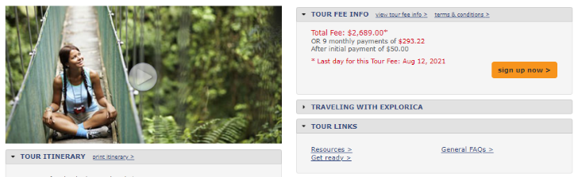




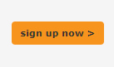

How to enroll
You can enroll your child through any of the following methods:
  Online at explorica.com/Engle-1751
  By phone at 1-888-310-7121
  By mail when you complete the paper application and send it to:
    Explorica
    P.O. Box 9033
    Charlottesville, VA 22906-9033
Sample Tour Center

Slide 21

Thanks for joining us!
Questions? Please contact:
Program Leader: Danielle Engle
Email: danielle.engle@cobbk12.org
We can’t wait to travel with you!

